Slide 1


QGIS
A free powerful alternative to ArcMap
May 21-22, 2018

Slide 2

QGIS
Quantum Geographical Information Systems (QGIS)
Released in 2009, QGIS is still a relativity new software with a promising longevity. Users from all over the world are attracted to the clean interface and fast processing speeds.
The most appetizing feature about QGIS is the that this software is open source, which makes it free for anyone to download.
Delivering Excellence with Every Solution
2

Slide 3
QGIS
Quantum Geographical Information Systems (QGIS)
Can be used for any common GIS task that can be done in ArcMap
Reading shapefiles and rasters.
Reading tabular data, such as wells locations based on lat/long.
Making maps.
Georeferencing images.
More complex GIS tasks
Interpolation.
Projecting data.
Geoprocessing, e.g. calculating the area of a shapefile
Delivering Excellence with Every Solution
3

Slide 4
QGIS
Open Source vs Closed source
Open source means that the software is not proprietary, is free and anybody can use the software and modify if desired.
Examples of other open source projects include:
Python
Linux
Even Google assistant (Google home)
Examples of closed source projects include:
Anything developed by Microsoft (such as MS office)
ESRI products like ArcMap and Arcpy
Adobe
Pretty much any software you would have to pay for
Delivering Excellence with Every Solution
4

Slide 5
QGIS vs ArcMap
QGIS
Supports more file structures
Free plugins
Faster processing
Cross platform (Windows, Apple, Linux)
ArcMap
Only supports a few files like shapefiles and geodatabases
Pay to use more features
Built on older versions so processing is slower
Only available on Windows
Delivering Excellence with Every Solution
5

Slide 6
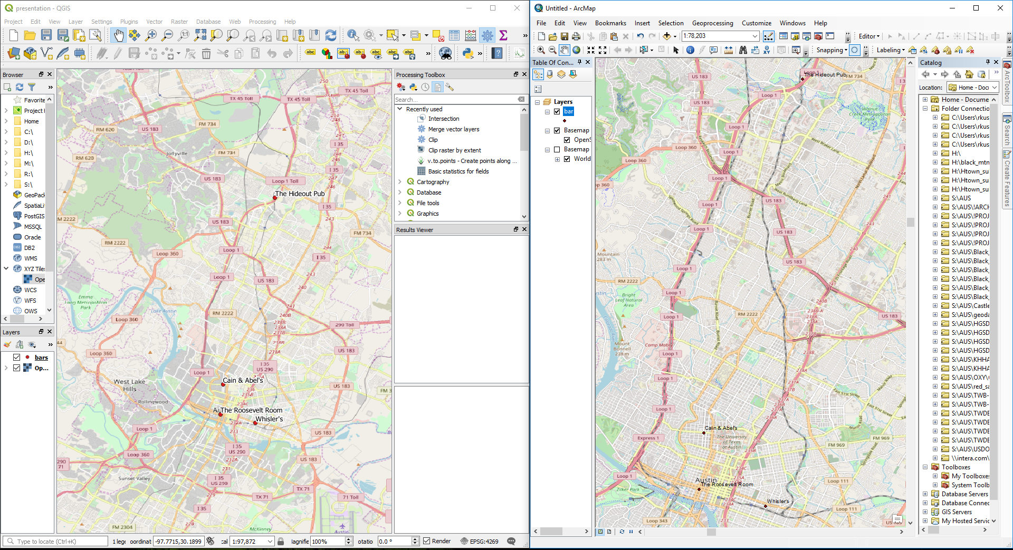
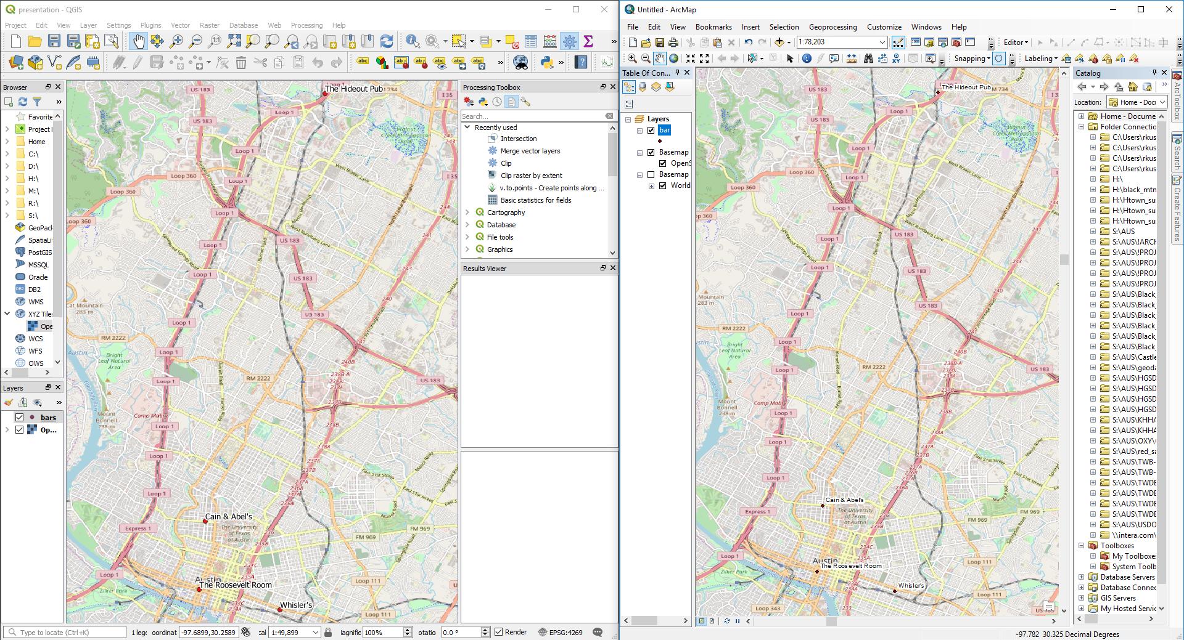
QGIS vs ArcMap (Data View)
QGIS
ArcMap
Delivering Excellence with Every Solution
6

Slide 7
QGIS vs ArcMap (Data View)
Both QGIS and ArcMap’s data view windows allow for:
Adding features
Adding basemaps
Showing layers (turn on/off)
Display area
QGIS
ArcMap
Delivering Excellence with Every Solution
7

Slide 8
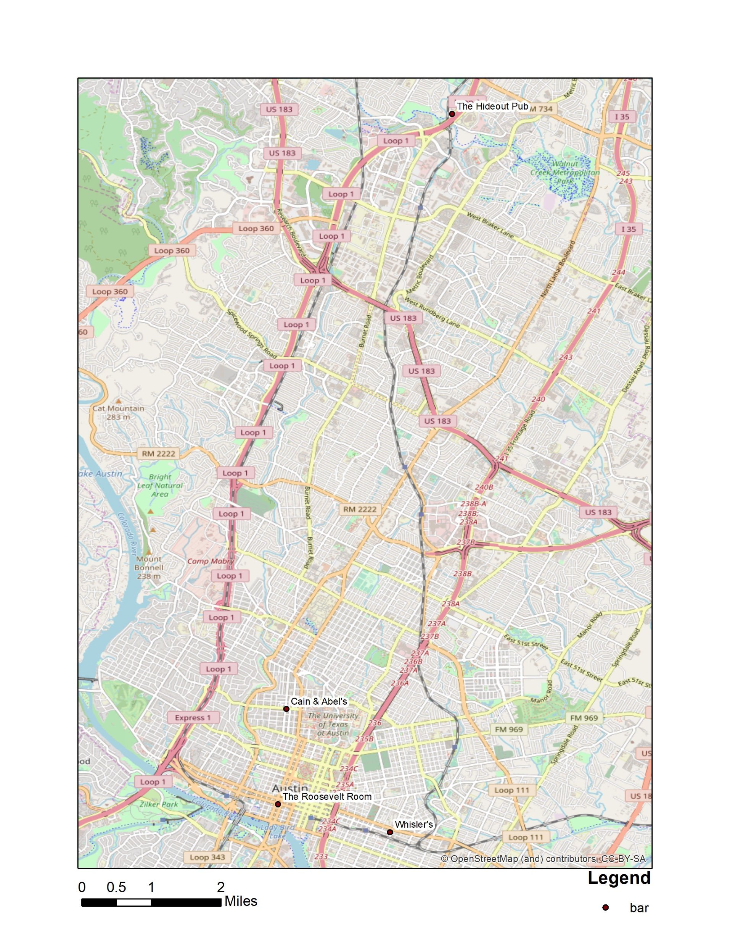
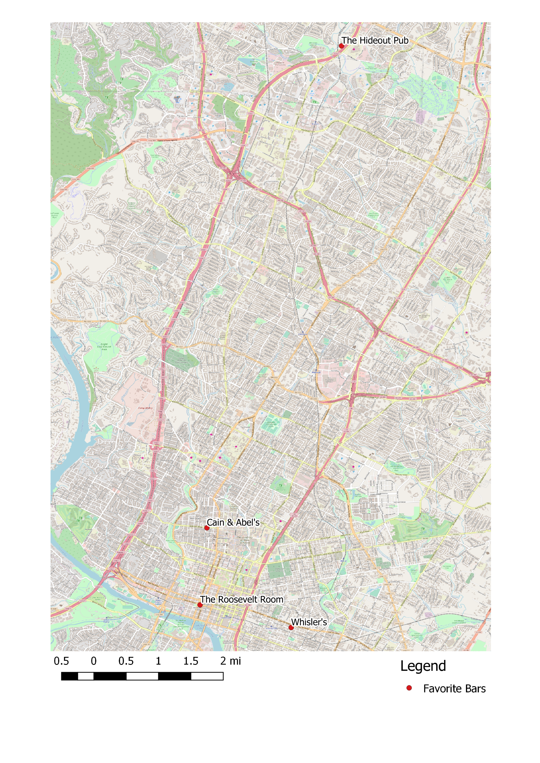
QGIS vs ArcMap (Layout View)
QGIS
ArcMap
Delivering Excellence with Every Solution
8

Slide 9
QGIS vs ArcMap (Layout View)
Both QGIS and ArcMap’s layout view windows allow for:
Adding titles and text
Adding legends
Scalebars
Importing images such as North Arrows
QGIS
ArcMap
Delivering Excellence with Every Solution
9

Slide 10
QGIS: Example
In this presentation, we will perform some simple routines a GIS analyst would often perform.
(In this case an informal survey of people’s favorite bars in Austin TX)
We will:
Create a csv file with coordinates
Add the csv to QGIS and view the data
Add a basemap, and label the points
Use the map layout tool
Add Scalebar and Legend
Export png or pdf
Delivering Excellence with Every Solution
10

Slide 11
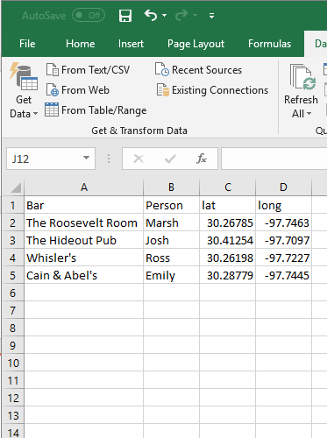
QGIS: Example
Input Data
Delimited (csv) file with point data
Delivering Excellence with Every Solution
11

Slide 12
QGIS: Example
Add csv or delimited text files
Can be used for any common GIS task
Reading shapefiles and rasters.
Reading csv tabular data.
Making maps.
Georeferencing images.
More complex GIS tasks
Interpolation.
Projecting data.
Geoprocessing.
Ex (Calculating the area of a shapefile)
Delivering Excellence with Every Solution
12

Slide 13
QGIS: Example
Add a Basemap
Can be used for any common GIS task
Reading shapefiles and rasters.
Reading csv tabular data.
Making maps.
Georeferencing images.
More complex GIS tasks
Interpolation.
Projecting data.
Geoprocessing.
Ex (Calculating the area of a shapefile)
Delivering Excellence with Every Solution
13

Slide 14
QGIS: Example
Add Labels
Can be used for any common GIS task
Reading shapefiles and rasters.
Reading csv tabular data.
Making maps.
Georeferencing images.
More complex GIS tasks
Interpolation.
Projecting data.
Geoprocessing.
Ex (Calculating the area of a shapefile)
Delivering Excellence with Every Solution
14

Slide 15
QGIS: Example
Open the map layout tool
Can be used for any common GIS task
Reading shapefiles and rasters.
Reading csv tabular data.
Making maps.
Georeferencing images.
More complex GIS tasks
Interpolation.
Projecting data.
Geoprocessing.
Ex (Calculating the area of a shapefile)
Delivering Excellence with Every Solution
15

Slide 16
QGIS: Example
Map Layout
In the Map Layout feature you can:
Add legend(s)
Add scalebar
Add title and text
Export map to image or pdf
Delivering Excellence with Every Solution
16

Slide 17
QGIS
Add Background, Scale Bar and Legend
Can be used for any common GIS task
Reading shapefiles and rasters.
Reading csv tabular data.
Making maps.
Georeferencing images.
More complex GIS tasks
Interpolation.
Projecting data.
Geoprocessing.
Ex (Calculating the area of a shapefile)
Delivering Excellence with Every Solution
17

Slide 18
QGIS
Adjust Legend
Can be used for any common GIS task
Reading shapefiles and rasters.
Reading csv tabular data.
Making maps.
Georeferencing images.
More complex GIS tasks
Interpolation.
Projecting data.
Geoprocessing.
Ex (Calculating the area of a shapefile)
Delivering Excellence with Every Solution
18

Slide 19
QGIS
From here we can export to a pdf or png
Can be used for any common GIS task
Reading shapefiles and rasters.
Reading csv tabular data.
Making maps.
Georeferencing images.
More complex GIS tasks
Interpolation.
Projecting data.
Geoprocessing.
Ex (Calculating the area of a shapefile)
Delivering Excellence with Every Solution
19

Slide 20
QGIS: My History
INTERA has been using QGIS lightly for several years, but has been moving towards increased use to reduce licensing burden while maintaining productivity.
Many scientists/engineers do not use Windows computers and QGIS has provided the way to continue the development of GIS tools
I personally started using QGIS because it would be hard to obtain a license while my coworkers were using them.
Delivering Excellence with Every Solution
20

Slide 21
QGIS: In Closing
QGIS provides a free alternative to ArcMap
QGIS is capable of performing many GIS tasks
The interface is easily learnable by those familiar with ArcMap
Potential tradeoff: there is nobody from whom you can purchase support; however, there are many online resources.
Delivering Excellence with Every Solution
21

Slide 22
QGIS: Resources
INTERA
Ross Kushnereit
rkushnereit@intera.com
512-425-2012
Link to this presentation
https://github.com/rosskush/qgis_presentation
QGIS
Link to download: https://qgis.org/en/site/forusers/download.html
Tutorials: https://www.qgistutorials.com/en/
Also lots of good tutorials on youtube.
Delivering Excellence with Every Solution
22

Slide 23
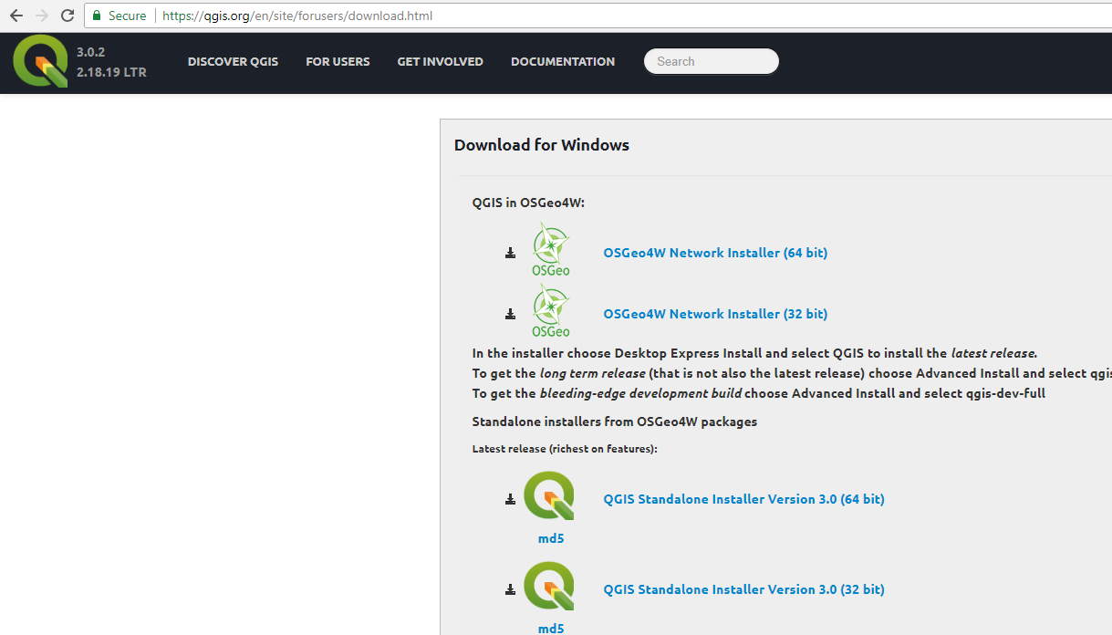
QGIS: Download
Delivering Excellence with Every Solution
23

